Slide 1
ANALYSIS OF BIT COIN & CRUDE OIL
Sai Siva Ramabhadra Raju Tirumalaraju
Vivek Adithya Mohankumar

Slide 2
Variables Under Study
Crude Oil
West Texas Intermediate(WTI), which is used as a bench mark in oil prices.
Bit Coin
Bitcoin is a form of digital currency, created and held electronically. No one controls it and prints it unlike USD or Euro.
Data Span and Source: Weekly Data from Aug 2011 to Oct 2016 from Data Stream

Slide 3
Plots at Level

Slide 4
Plots at Log Transformation

Slide 5
Plots at First Difference

Slide 6
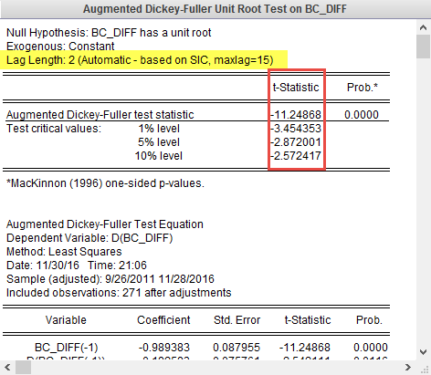
Unit Root Test - ADF
The ADF test for stationarity proves that
the data is stationary at 5% and 10% confidence levels

Slide 7
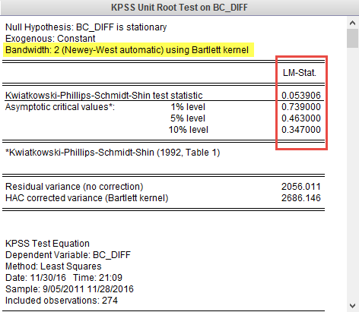
Unit Root Test - KPSS
The KPSS test for stationarity proves that
the data is stationary at 5% and 10% confidence levels

Slide 8
Multivariate Analysis of Bit Coin and Crude Oil

Slide 9
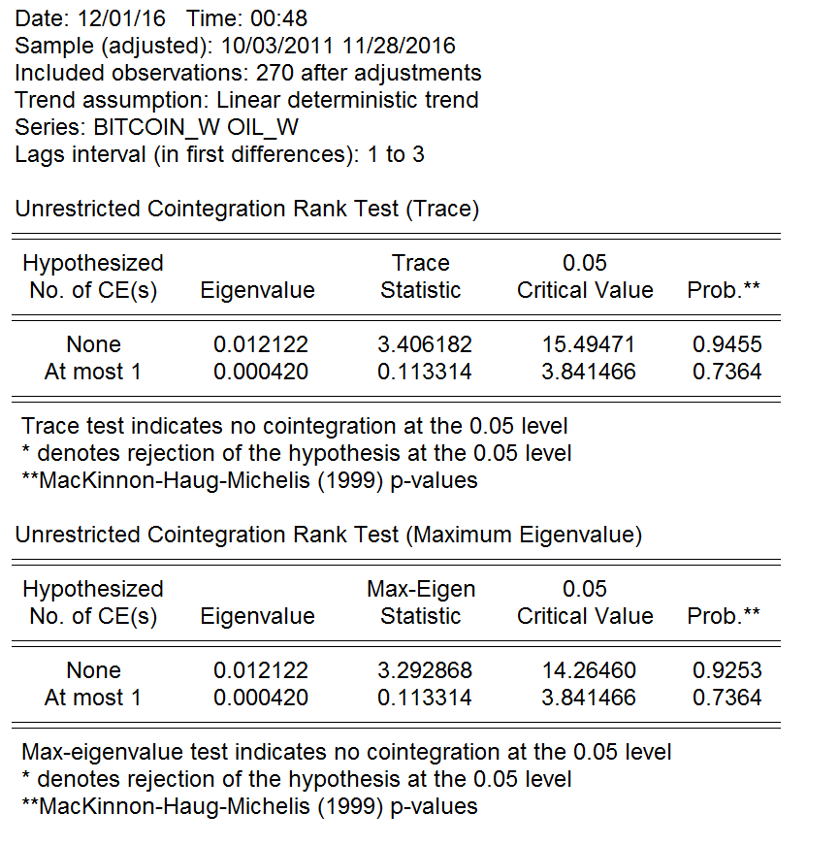
Co Integration
Both bitcoin and crude oil are I(1) stationary.
Johansen cointegration test is performed to check for cointegration

Slide 10
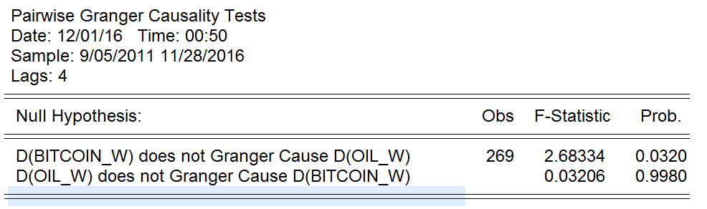
Granger Causality
Causality tests show bit coin granger cause oil.

Slide 11
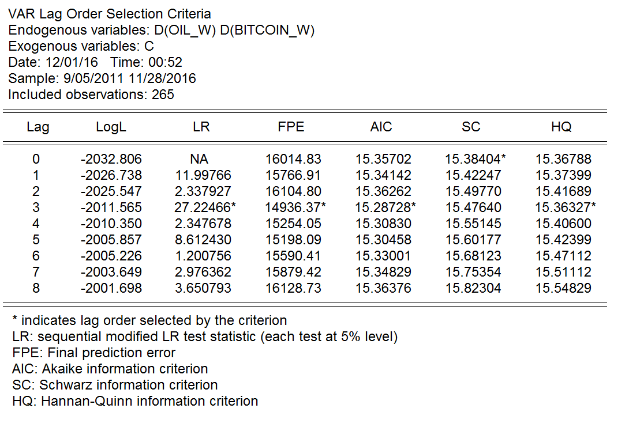
Lag Length Selection
Based on AIC, a lag length of 3 is selected
VAR(3) modeling.

Slide 12
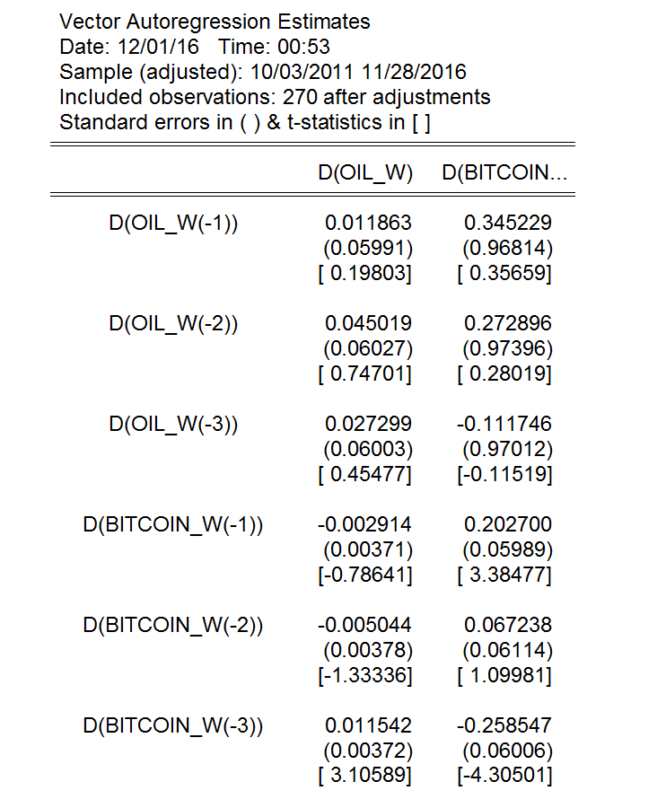
VAR(3) Estimation
Bit coin significant on to itself.
Oil is significant for btcoin(-3).

Slide 13
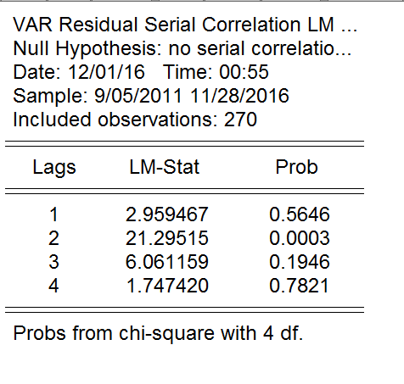
Serial Correlation
LM test.
No evidence of serial correlation

Slide 14
Impulse Response
Response of oil onto bitcoin.
Shocks decaying over time.

Slide 15
Auto Regressive Distributed Lag

Slide 16
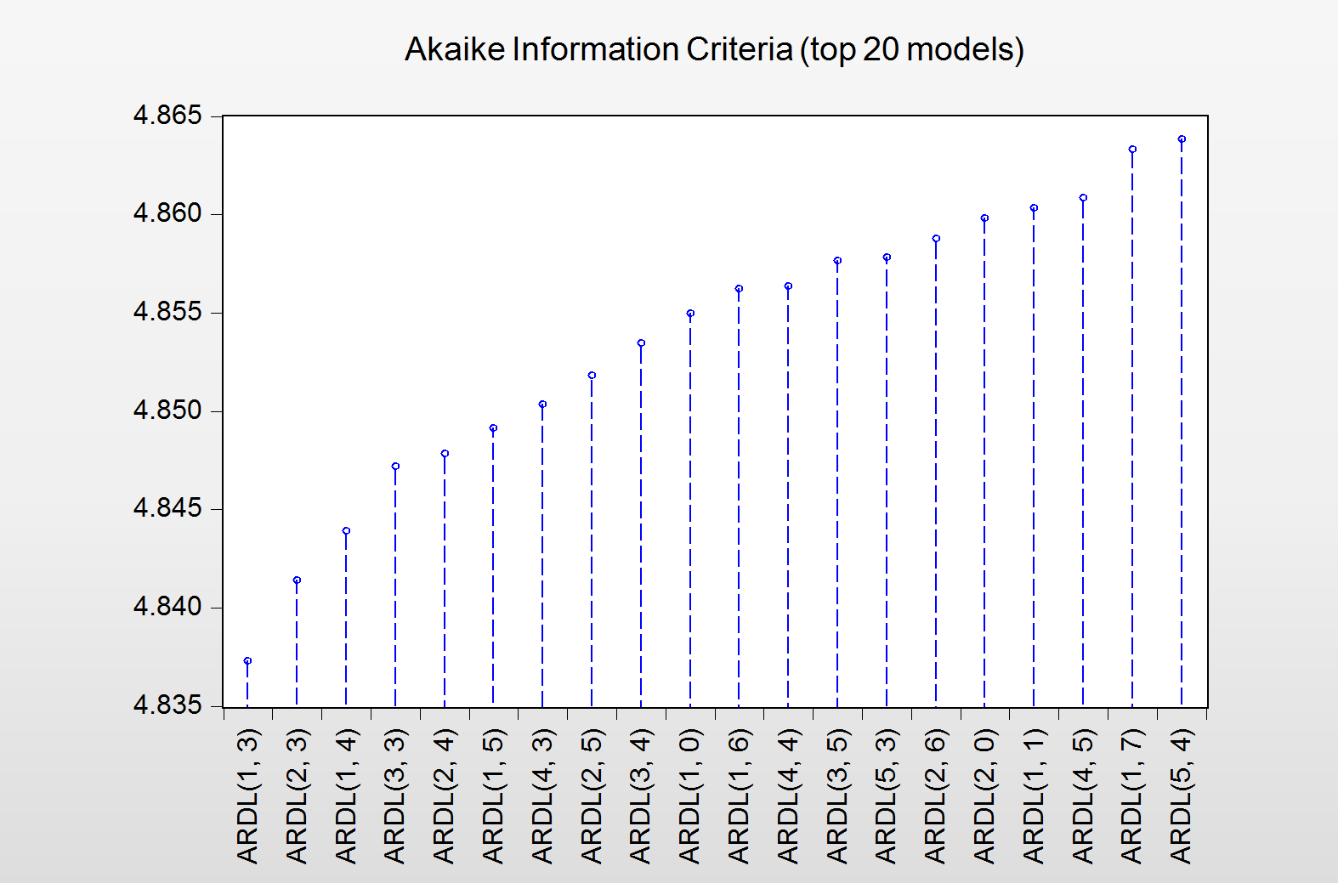
Lag length selection using AIC.
ARDL(1,3)

Slide 17
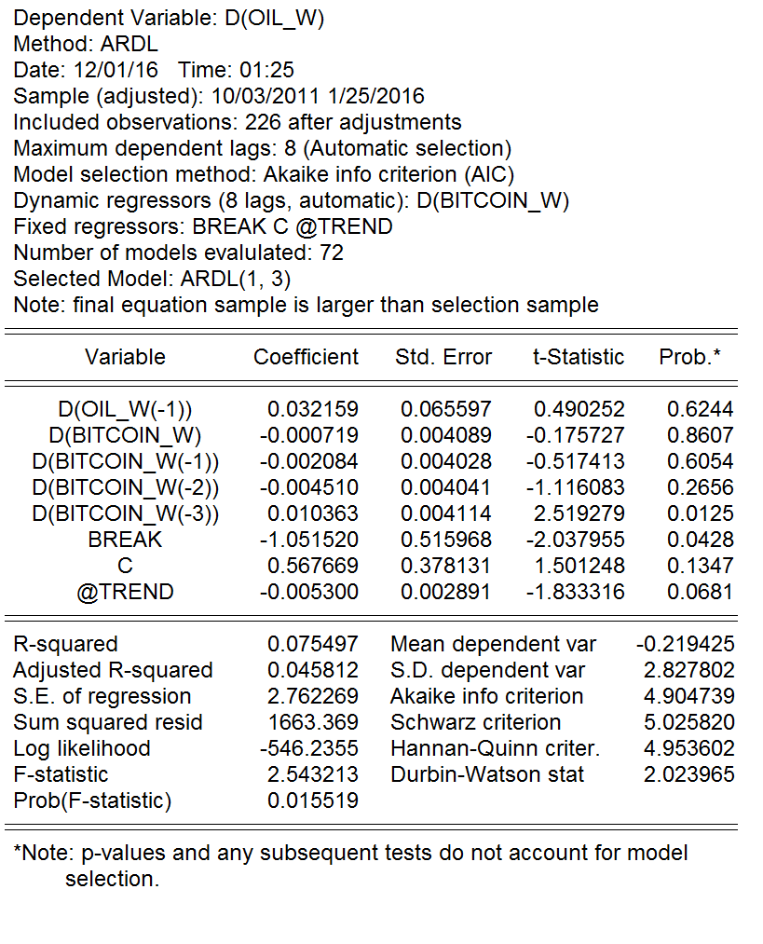
ARDL(1,3)
Oil onto bitcoin(-3) significant

Slide 18
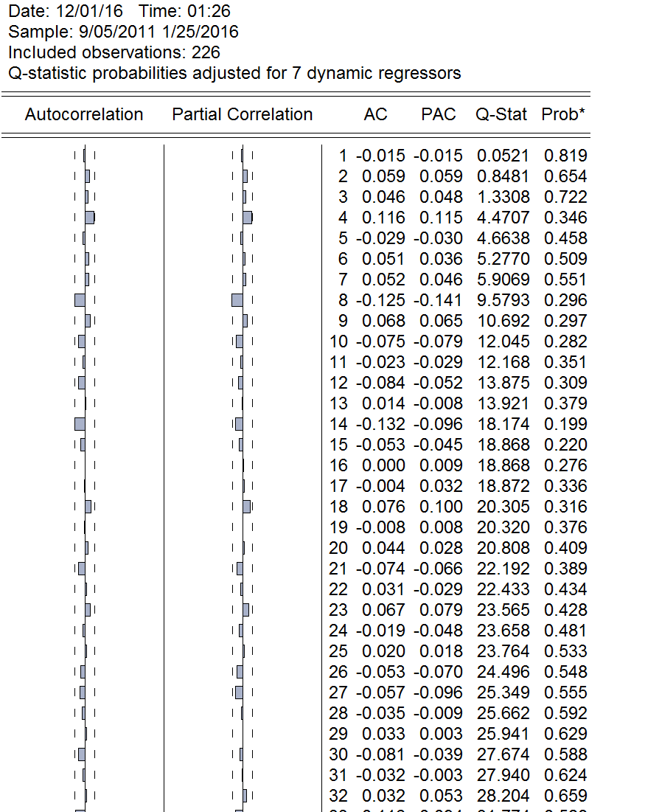
Serial correlation
Using correlogram Q-statics to check serial correlation.
Results show no evidence.

Slide 19
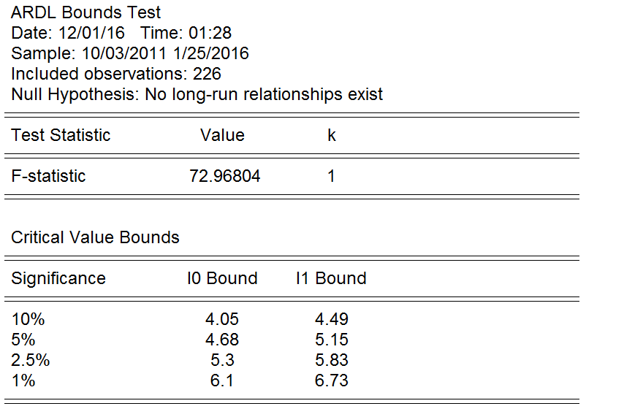
Long run relationship.
Bounds test.
Indicates long run relationship.

Slide 20
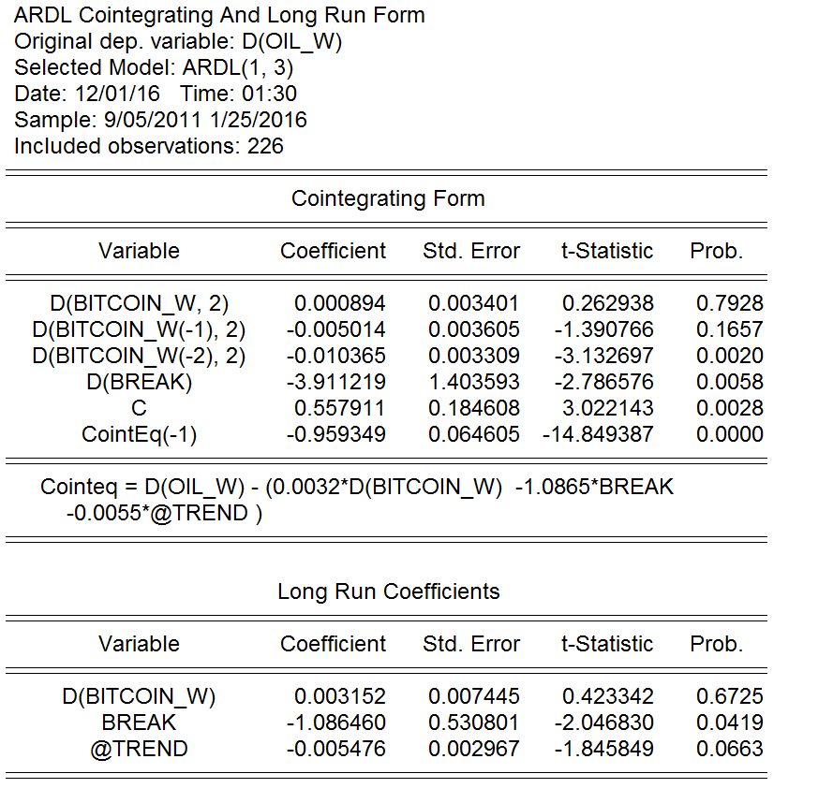
Co-integrating and long run form.
long-run equilibrium relationship between the price of crude oil and bitcoin.

Slide 21
Univariate Analysis of Bit Coin

Slide 22
Correllogram

Slide 23
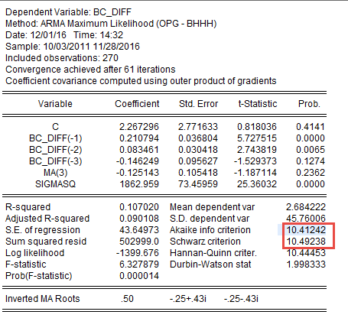
Model Estimation ARMA(3,3)
AIC : 10.41
BIC : 10.49

Slide 24
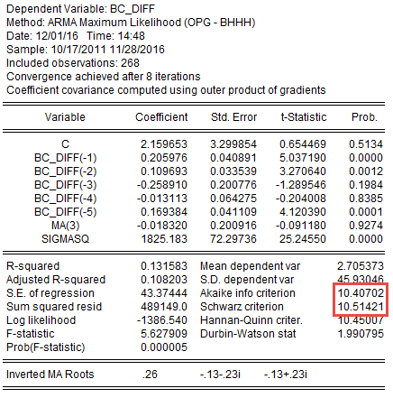
Model Estimation ARMA(5,3)
AIC : 10.40
BIC : 10.51

Slide 25
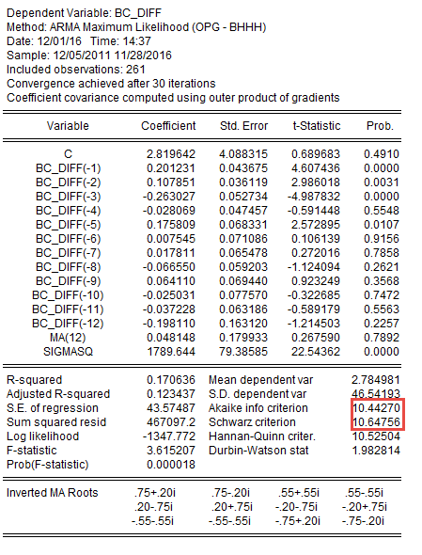
Model Estimation ARMA(12,12)
AIC : 10.44
BIC : 10.64

Slide 26
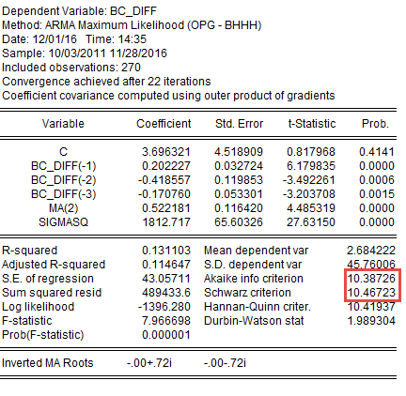

Model Estimation ARMA(3,2)
AIC : 10.38
BIC : 10.46

Slide 27
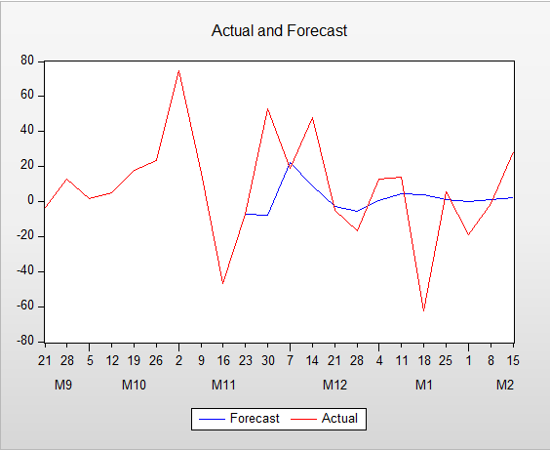
ARMA (3,2) Forecast

Slide 28


